Slide 1
Test of Significant Toxicity: Time for Change
Lei Zheng²
John Fox¹, Debra Denton¹ Jerry Diamond²
U.S. Environmental Tetra Tech Inc.
Protection Agency Baltimore, MD, U. S. A.
Office of Research and Development
Full Name of Lab, Center, Office, Division or Staff goes here.
Notes:
It has been a great meeting so far. I will want to achknowledge my coauthors for putting a lot of effort into this presentation.

Slide 2
Clean Water Act 1972 in the U.S.
To Restore and Maintain the Chemical, Physical, and Biological Integrity of the Nation's Waters
Implemented pollution control programs such as setting wastewater standards for industry;
Set water quality standards for all contaminants in surface waters.
Notes:
First I want to give you some background on water quality monitoring in the United States.
IN 1972, a landmark law has changed the entire country and brought huge implications to water quality in the United States, which is the Clean water Act.
The statute employs a variety of regulatory and nonregulatory tools to sharply reduce direct pollutant
discharges into waterways, finance municipal wastewater treatment facilities, and manage polluted runoff.
Aquatic Toxicity (Whole Effluent Toxicity, WET) Testing in the U.S. or Whole Effluent Assessment (WEA) in Europe

Slide 3
Set Goals and Water Quality Standards (WQS)
Conduct Monitoring
← No ← Meeting WQS? → Yes
303(d)
Develop Strategies and Controls (TMDLs)
Apply Antidegradation
Implement Strategies
NPDES Section 401
Section 319 Section 404
State Revolving Fund (SRF)
Clean Water Act: The Big Picture
Notes:
CWA: The Big Picture
This diagram provides brief summary of CWA elements to protect water quality in the US.
Major CWA programs : 1) water quality standards, 2) antidegradation policy, 3) waterbody monitoring and assessment, 4) reports on condition of the nation’s waters, 5) total maximum daily loads (TMDLs), 6) NPDES permit program for point sources, 7) Section 319 program for nonpoint sources, 8) Section 404 program regulating filling of wetlands and other waters; 9) Section 401 state water quality certification; 10) state revolving loan fund (SRF).
Brief Overview of Key CWA Elements
First, water quality standards (WQS) consistent with the statutory goals of the CWA must be established. Then waterbodies are monitored to determine whether the WQS are met.
If all WQS are met, then antidegradation policies and programs are employed to keep the water quality at acceptable levels. Ambient monitoring is also needed to ensure that this is the case.
If the waterbody is not meeting WQS, a strategy for meeting these standards must be developed. The most common type of strategy is the development of a Total Maximum Daily Load (TMDL). TMDLs determine what level of pollutant load would be consistent with meeting WQS. TMDLs also allocate acceptable loads among sources of the relevant pollutants.
Necessary reductions in pollutant loading are achieved by implementing strategies authorized by the CWA, along with any other tools available from federal, state, and local governments and nongovernmental organizations. Key CWA tools include the following:
NPDES permit program(national pollutant discharge ellimination system) Covers point sources of pollution discharging into a surface waterbody.
Section 319 Addresses nonpoint sources of pollution, such as most farming and forestry operations, largely through grants.
Section 404 Regulates the placement of dredged or fill materials into wetlands and other Waters of the United States.
Section 401 Requires federal agencies to obtain certification from the state, territory, or Indian tribes before issuing permits that would result in increased pollutant loads to a waterbody. The certification is issued only if such increased loads would not cause or contribute to exceedances of water quality standards.
State Revolving Funds (SRF) Provides large amounts of money in the form of loans for municipal point sources, nonpoint sources, and other activities.
After implementation of these strategies, ambient conditions are again measured and compared to ambient water quality standards. If standards are now met, only occasional monitoring is needed. If standards are still not being met, then a revised strategy is developed and implemented, followed by more ambient monitoring. This iterative process must be repeated until standards are met.

Slide 4
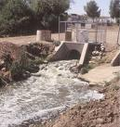
NPDES permit program and WET
NPDES (national pollutant discharge elimination system): point sources
WET (whole effluent toxicity) or WEA (Whole Effluent Assessment)
Note: WET outside of North America is also variously known as Direct Toxicity Assessment (UK) or Whole Effluent Assessment (WEA)
Notes:
What Types of Discharges are Subject to WET Testing?
Major discharges: usually ≥ 1 million gallons per day
All municipal wastewater plants in some states
Any discharge that may contain toxic chemicals
Can include stormwater, non-contact cooling water, produced water discharges

Slide 5
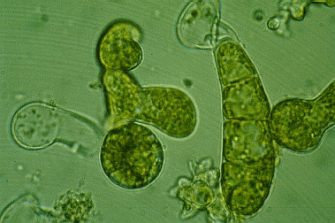
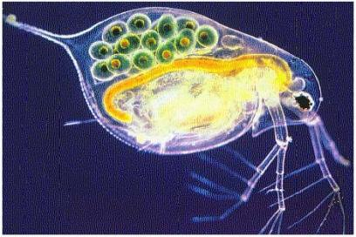
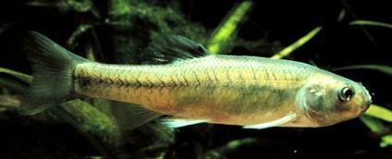
Effluent Compliance Monitoring
in the U.S.
Biological Assessment
Chemical Monitoring
Effluent Compliance
Giant kelp sporophyte
Ceriodaphnia
WET Testing
Fathead minnow
Notes:
One of the three effluent monitoring program in the US
Bioassessment rarely used; States rely on WET and chemical monitoring
WET monitoring uses mostly fish and invertebrate testing; algae or plant testing used in only a few states (e.g., marine discharges on the West Coast U.S.)
Frequency of WET testing, how results are interpreted, and how non-compliance is determined varies among States and regions

Slide 6
The Process

Slide 7
Water samples tested
“Ambient”: Stormwater & Receiving Water (i.e., stream, river)
sample tested at 100% (undiluted); two-concentration test (sample plus control)
Effluent samples: multi-concentration test (dilution series)
e.g. 100%, 75%, 50%, 25%, 12.5%, and control, 0%
Effluent discharge permit identifies “in-stream waste concentration” = “IWC”
Middle dilution should be the IWC (unless IWC is 100%)
Toxicity should not occur at concentrations ≤ IWC; IWC is site specific.
Notes:
IWC can be 100% to <10% of whole effluent

Slide 8
Toxicity Tests
Acute Tests: lethal concentrations
% Survival (LC50)
Chronic Tests: predictive of full life cycle effects
Biological effects are sublethal (plus survival)
growth – biomass, weight, length
reproduction – number of offspring
% fertilization, % larval development
Notes:
• The first decision for a permit writer is to determine whether a permittee should conduct acute or chronic tests to address acute & chronic criteria.
• Acute – used to determine the concentration of effluent or ambient water that produces an adverse effect (mortality) on a group of test organisms during a 24-96 hour exposure.
• Usually measures toxicity of fast-action chemicals, such as chlorine or pesticides.
• One disadvantage of “kill them and count them” tests is that they only indicate lethal concentrations. Acute testing requirement might be satisfied during a chronic test by measuring survival at a given time. This is called dual endpoint testing.
• Chronic – short-term test in which sublethal effects are usually measured in addition to lethality. Traditional chronic tests were inconveniently long in duration; therefore EPA has come up with short-term chronic tests. These tests were developed and selected based on sensitive species, life-stages and endpoints, taxonomic and ecological diversity, short duration, availability of organisms, and low volume requirements.
•Usually more sensitive to low level contamination

Slide 9
Two Statistical Approaches
Hypothesis Test - Does a critical concentration of the sample show a statistically significant decrease in organism response as compared to the control?
Multiple Concentration – NOEC(No observed Effect Concentration) /LOEC (Lowest Observed Effect Concentration)
Single Concentration - Test of Significant Toxicity (TST) or t-test
Point Estimates - At what sample concentration is an effect observed and is the critical concentration (IWC) less than this value?
Multiple Concentration - LC₅₀ (Acute), EC₂₅ or IC₂₅ (Chronic)

Slide 10
Objectives from different views
Regulators
Provide maximum protection of waters with high precision test (probably require higher cost)
Permittee
Spend least amount of money to get a permit
Finding Common Ground:
Improving Precision while reducing Cost

Slide 11
Purpose of Hypothesis Tests
and Basic Considerations
Purpose:
Determine if biological response of tested concentrations are different than the control
Considerations:
Statistical significance vs. biological significance
Interpretation affected by power of statistical test (number of replicates; within-test variability) and number of concentrations tested
Can be conducted as a 5-concentration (NOEC) or 2-concentration test (t-test)

Slide 12
Test Design and Test Power
Test design includes:
Number of organisms/replicate
Number of replicates per treatment (concentration)
The greater the # replicates or # organisms/ replicate, the greater the test power (all else being equal)
decreases within-test variance
increases the probability of declaring a significant difference between effluent and control
But does increased test power lead to greater confidence in results using the traditional hypothesis approach?

Slide 13
Current hypothesis test approach
To declare “toxic”, reject Ho: effluent = control
μ_{effluent} = μ_{control}
low precision: toxic sample may be declared “not toxic”; low power confirmed for some WET tests
high precision: non-toxic sample may be found “toxic” Ho rejected for small & negligible differences
disincentive to increasing precision and power
Problems of the ‘nil null’ hypothesis and NOEC or NOAEL have been discussed for years. Good alternatives are available. Changes to regulatory practices are gradually being adopted.
Notes:
On last bullet on this slide provide explanation from section 5.2 of 9/14/09 draft TST guidance as to why the permittee has more control over interpretation of WET tests using TST because…
Low Power:
Denton DL, Norberg-King TJ. 1996. Whole effluent toxicity statistics: A regulatory perspective. In Grothe DR, Dickson KL, Reed-Judkins DK,
eds, Whole Effluent Toxicity Testing: An Evaluation of Methods and Prediction of Receiving System Impacts. SETAC, Pensacola, FL, USA,
pp 83–102.
Oris J, Belanger S, Bailer AJ. 2011. Baseline characteristics and statistical implications for the OECD 210 fish early-life stages chronic toxicity test. Environ Toxicol Chem 31:370–376.
USEPA. 2000. Understanding and accounting for method variability in whole effluent toxicity applications under the National Pollutant Discharge Elimination System Program. Denton DL, Fox J, Fulk FA, Greenwald K, Narvaez M, Norberg-King TJ, Phillips L, editors. Office of Water. Washington, DC. EPA/833/R-00/003.

Slide 14
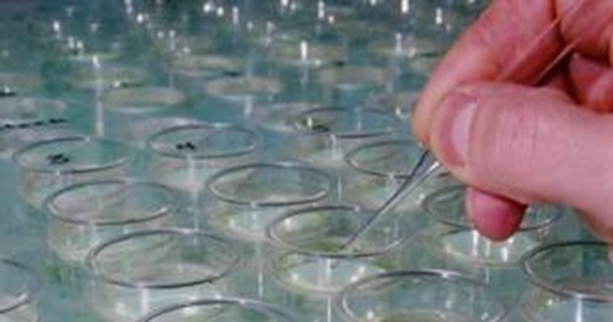
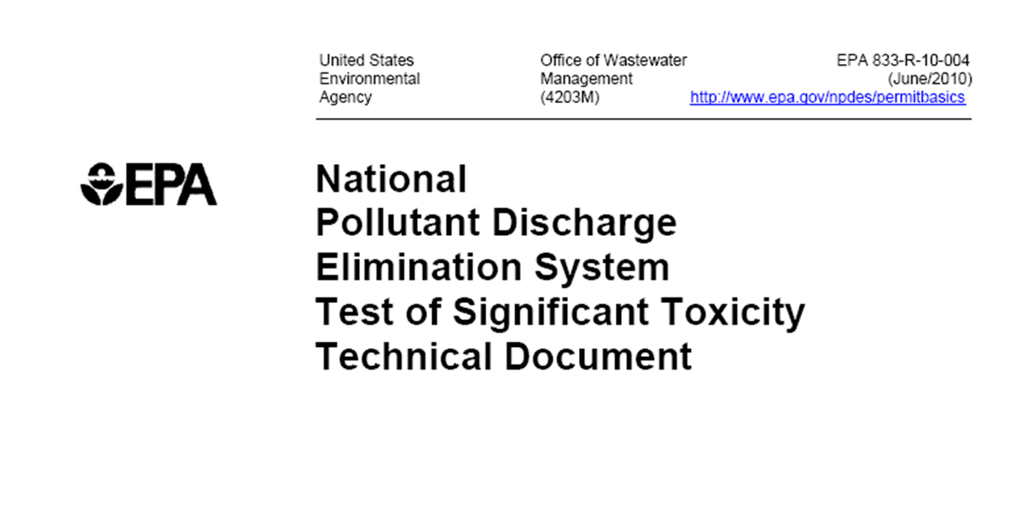
Test of Significant Toxicity (TST)

Slide 15
How is TST Different from Other
U.S. EPA Analysis Approaches?
TST uses explicit regulatory management decisions (RMDs) and test design error rates to ensure that:
Biologically insignificant effects are declared non-toxic most of the time
Unacceptable toxicity is identified as toxic most of the time
Result is that regulatory decisions will have higher confidence and will be more transparent using TST.

Slide 16
TST WET Analysis Approach
Two-sample comparison (control, IWC)
Proof-of-safety (non-inferiority test); set a threshold ratio-to-control b
H_{o}: μ_{effluent} < b * μ_{control}
Use Welch t-test: assumptions were evaluated for acute and chronic WET test biological endpoints

Slide 17
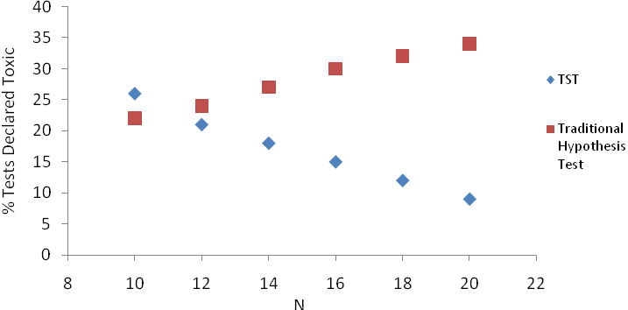
Example for Ceriodaphnia chronic reproduction b = 0.75 (critical effect size 25% decrease) effluent ratio to control = 0.78 (actual effect size 22% decrease)
Notes:
Effluent is below than threshold (25% loss in Repro) for critical effect size
WE WANT POWER TO DECREASE WITH INCREASING SAMPLE SIZE
With increasing number of replicates N:
Traditional null hypothesis declares more and more samples toxic
TST declares fewer samples toxic

Slide 18
TST: Paradigm Shift for WET Testing applied to compliance monitoring
Only control and IWC are statistically compared
Lower cost than multi-concentration test
Replication (N) can be increased
Permittee must demonstrate that IWC is not toxic
Toxicity has been documented previously
Cause to exceed limit has been established (“Reasonable Potential Determination”)

Slide 19
TST: Welch t-test suitable?
Chronic test biological endpoints:
Distributions are leptokurtic; extremes are truncated by Test Acceptability Criteria
Unequal variances for Control & Effluent
Effluent skewed to left (non-normal)
Acute toxicity test survival endpoint: arcsin transform
Welch t-test has close to nominal level (simulated WET data, Zheng et al. 2013; and other studies)
Notes:
MacDonald P. 1999. Power, type I, and type II error rates of parametric and nonparametric statistical tests. J Exp Educ 67:367–379.
Fagerland MW, Sandvik L. 2009. The Wilcoxon-Mann Whitney test under scrutiny. Stat Med 28:1487–1497.
Ruxton GD. 2006. The unequal variance t test is an underused alternative to Student’s t-test and the Mann-Whitney U test. Behav Ecol 17:688–690.
Zimmerman D. 2006. Two separate effects of variance heterogeneity on the validity and power of significance tests of location. Stat Methods 3:351–374.

Slide 20
TST: setting b, α, N
Bioequivalence value b is a decision for regulators: a degree of toxicity that is likely to be biologically important
Error rates α,β are specific to each test design and based on precision achieved by most labs
Number of replicates (N) is set by method
Discharger can increase N to lower risk of false positives, at lower cost than multi-concentration test

Slide 21
Setting bioequivalence value b
When μ_{Effluent} / μ_{Control} ≥ b, consider this is not a harmful response (lower potential for harm to aquatic life)
For chronic tests: b = 0.75 (25% effect)
Agrees with use of IC25 as point estimate. IC25 associated with adverse ecological impacts in field studies: USEPA, 1986)
For acute tests: b = 0.80 (20% effect)

Slide 22
Setting desired error rates: Objectives
Chronic Tests
≥ 75% of tests declare sample toxic when effect is ≥ 25% (ratio to control < 0.75)
Acute Tests
≥ 75% of tests declare sample toxic when effect is ≥ 20% (ratio to control < 0.80)
Both:
≤ 5% of tests declare sample toxic when effect is ≤10% (ratio to control < 0.90)

Slide 23
Setting error rates: procedure
Estimate test precision from historical data
use 50th, 75th, 90th percentiles for coefficient of variation (CV) of biological response at control
Calculate power curves Pr{“toxic”} = Pr{Ho not rejected} for α = {0.05, 0.10, 0.15, 0.20, 0.25} at each CV
Find smallest α at highest CV that satisfies both
power >= 0.75 at μ_{Effluent} / μ_{Control} = b (25% effect)
power <= 0.05 at μ_{Effluent} / μ_{Control} = 0.90 (10% effect)

Slide 24
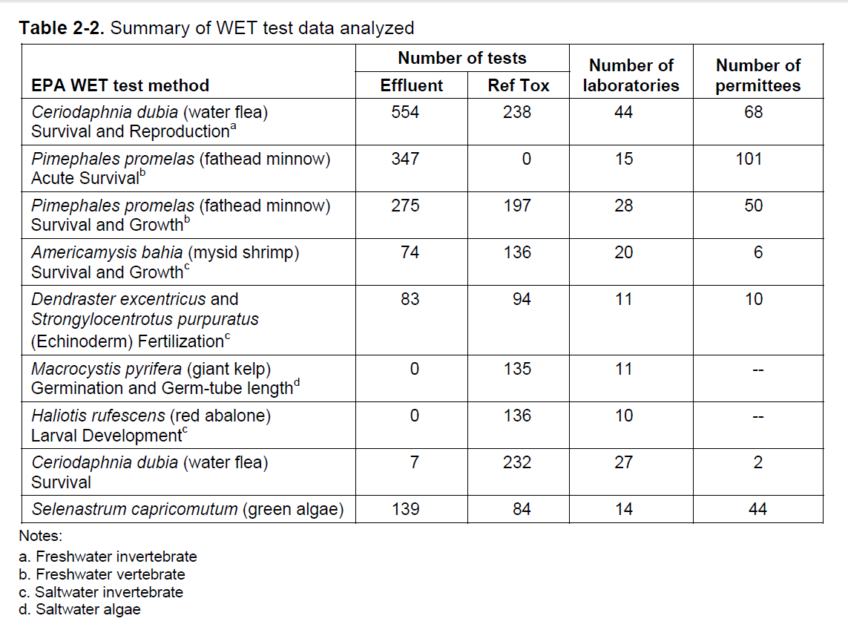
Historical data

Slide 25
Setting error rates: assumptions
Assume that biological endpoint is normally distributed
Assume equal variances for control and effluent
use historical data on control variances
Test method and design (number of replicates and 5 dilutions) as required by EPA
Standard power calculation (non-central t)

Slide 26
Setting error rates
Notes:
Power defined here as prob. null is NOT rejected (or proportion of samples declare toxic)
Choose alpha to satisfy both power > 0.75 at ratio-to-control 0.75 AND power ><0.05 at ratio-to-control 0.90
Start with highest CV (90th percentile), move lower if necessary
Choose alpha-curve with both points filled or choose alpha-curve falling into both boxes (dashed lines)

Slide 27
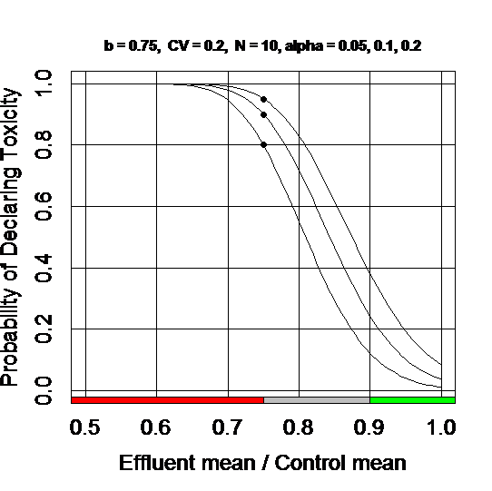
It doesn’t always work well for every test: Ceriodaphnia reproduction, N=10, 75th %ile CV = 0.20

Slide 28
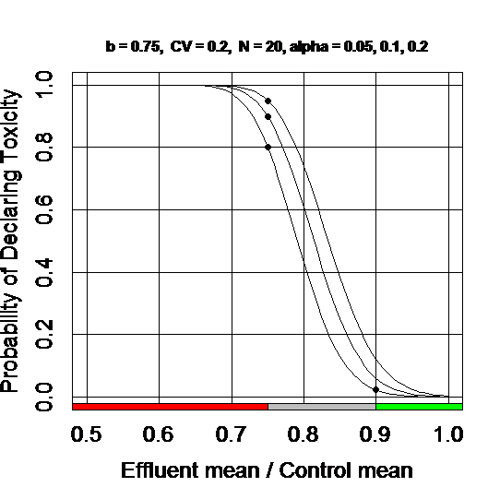
Increased “n” is recommended for this test method

Slide 29
Setting nominal error rate α for TST
WET Method | b | α | control CV | Percentile of control CV
Chronic Toxicity Tests
Fathead minnow growth | 0.75 | 0.25 | 0.11 | ~50th
Ceriodaphnia reproduction | 0.75 | 0.20 | 0.15 | 50th
Mysid shrimp growth | 0.75 | 0.15 | 0.13 | ~40th
Red abalone larval development | 0.75 | 0.05 | 0.05 | 75th
Sea urchin fertilization | 0.75 | 0.05 | 0.03 | 50th
Giant kelp germination | 0.75 | 0.05 | 0.05 | 75th
Giant kelp germ-tube length | 0.75 | 0.05 | 0.07 | 50th
Green alga growth | 0.75 | 0.25 | 0.10 | ~70th
Acute Toxicity Tests
Fish species survival | 0.80 | 0.10 | 0.01 | ~75th
Daphnid, mysid, & amphipod survival | 0.80 | 0.10 | 0.02 | ~85th
Notes:
It was known that power was weak for “older” chronic toxicity methods (Minnow, Ceriodaphnia, Green alga and Mysid)
For these methods, the need for higher alpha and lower percentiles is not surprising
Sample sizes can be increased for these tests if a laboratory is not achieving sufficient precision
The “West Coast” marine methods were designed later and designed to achieve suitable power.

Slide 30
How will TST perform for real effluent tests ?

Slide 31
“Test Drive” of TST
Acquired 890 multi-concentration WET tests on effluent from California and Washington States
Representative range of facilities, IWCs, types of waste treatment, WET testing laboratories
Compared TST and NOEC
Acquired 3,201 freshwater chronic toxicity tests (“ambient” toxicity: undiluted stream water & control)
Compared TST and t-test {H_{o}: μ_{effluent} = μ_{control}}
Diamond, Denton, Roberts & Zheng (2013) Environ. Toxicol. Chem. 32:1101-1108

Slide 32
Test Drive: Effluent Tests misclassification
All Chronic Toxicity Tests: effluent samples
 |  | TST declared: |  | NOEC declared:
 | N | Non-toxic | Toxic | Non-toxic | Toxic
All Effluent Samples | 890 | 757 | 133 | 753 | 137
E/C ≥ 0.75 (Effect < 25%) “Non-Toxic” | 786 | 757 | 29 | 743 | 43
E/C < 0.75 (Effect ≥ 25%) “Toxic” | 104 | 0 | 104 | 10 | 94
Risk of misclassification greater for NOEC
Notes:
NOEC has lower power and allows higher rate of false negatives, failing to declare toxicity when it should

Slide 33
Test Drive: Effluent Tests False Positives
All Chronic Toxicity Tests: effluent samples
 |  | TST declared: |  | NOEC declared:
 | N |  | Toxic |  | Toxic
All Effluent Samples | 890 |  | 133 |  | 137
E/C ≥ 0.75 (Effect < 25%) | 786 |  | 29 |  | 43
E/C > 0.90 (Effect ≤ 10%) | NR |  | 1 |  | 20
Risk of false positives greater for NOEC
Notes:
NOEC has lower power and allows higher rate of false negatives, failing to declare toxicity when it should

Slide 34
Test Drive: Ambient Water False Positives
All Chronic Toxicity Tests: ambient water samples
 |  | TST declared: |  | NOEC declared:
 | N |  | Toxic |  | Toxic
All Samples | 3201 |  | 578 |  | 529
E/C ≥ 0.75 (Effect < 25%) |  |  | 176 |  | 165
E/C > 0.90 (Effect ≤ 10%) |  |  | 2 |  | 21
Risk of false positives greater for NOEC
Notes:
NOEC has lower power and allows higher rate of false negatives, failing to declare toxicity when it should

Slide 35
Concluding Remarks - 1
For compliance monitoring, only one dilution is needed (“IWC”) and only one test or confidence interval
lower cost than multi-concentration test
user can increase replication and power at less cost
Traditional hypothesis test creates disincentive to increasing N or test precision (decreasing variability)
TST non-inferiority test is one way to explicitly control false positive and false negative rates
TST approach can decrease false positive rate (discharger’s risk) and decrease monitoring cost

Slide 36
Concluding Remarks - 2
Some States may want to continue multi-concentration testing and use of NOEC or IC25
There is concern that toxicity might be declared by chance (false positive) when there is no dose-response
confirm dose-response using a suitable trend test
For multi-concentration tests, avoid wasting power on Dunnett MCC for compliance verification
compliance with limit requires only one t-test
use pooled variance estimate (greater d.f.)
use more replicates at control & IWC if necessary

Slide 37
Next steps to assist users*
Power calculator in R (for decisions on N)
Laboratories can differ appreciably in precision achieved. Use historical data specific to lab and effluent discharge to reduce error rates?
Modify TST to better account for heterogeneous variances (normally distributed responses) and over-dispersion (survival)
* With acknowledgement & thanks to L. Hothorn for suggestions

Slide 38
References for WET and TST - 1
Denton D, Diamond J, Zheng L. 2011. Test of Significant Toxicity: A statistical application of assessing whether an effluent or site water is truly toxic. Environ. Toxicol. Chem. 30:1117-1126.
Diamond J, Denton D, Anderson B, Phillips B. 2011. It is time for changes in the analysis of whole effluent toxicity data. Integr. Environ. Assess. Manag. 8:351-358.
Zheng L, Diamond J, Denton D. 2013. Evaluation of Whole Effluent Toxicity Data Characteristics and Use of Welch’s T-Test in the Test of Significant Toxicity. Environ. Toxicol. Chem. 32:468-474.
Diamond J , Denton D, Roberts J, Zheng L. 2013. Evaluation of the test of significant toxicity (TST) for determining the toxicity of effluents and ambient water samples. Environ. Toxicol. Chem. 32:1101-1108.

Slide 39
References for WET and TST - 2
USEPA. 2000. Understanding and accounting for method variability in whole effluent toxicity applications under the National Pollutant Discharge Elimination System Program. Denton DL, Fox J, Fulk FA, Greenwald K, Narvaez M, Norberg-King TJ, Phillips L, editors. Office of Water. Washington, DC. EPA/833/R-00/003.
http://cfpub.epa.gov/npdes/docs.cfm?view=allprog&program_id=45&sort=date_published
http://www.toxicity.com/pdf/epa2000june.pdf
USEPA. 2010. National pollutant discharge elimination system test of significant toxicity technical document. EPA/833-R-10-004. U.S. Environmental Protection Agency, Office of Environmental Management, Washington, DC.
http://water.epa.gov/polwaste/npdes/basics/upload/wet_final_tst_implementation2010-2.pdf
State Water Resources Control Board (SWRCB). 2011. Whole Effluent Toxicity Test Drive Analysis of the Test of Significant Toxicity (TST). State of California State Water Resources Control Board, Sacramento (CA). November 2011.

